Slide 1
Network Intrusion detection using RYU-Controller and mininet
GROUP-8
GROUP MEMBERS
Abburi Sai Karthik AM.EN.U4AIE20001
Maddala H S M Krishna karthik AM.EN.U4AIE20046
Marasani Jayasurya AM.EN.U4AIE20048

Slide 2
Contents
Introduction
Problem Definition
Network Topology
Methodology
Implementation
Results
Conclusion

Slide 3
Intrusion Detection System
An Intrusion Detection System (IDS) is a system that monitors network traffic for suspicious activity and issues alerts when such activity is discovered.
It is a software application that scans a network or a system for the harmful activity or policy breaching.
Any malicious venture or violation is normally reported either to an administrator or collected centrally using a security information and event management (SIEM) system.
Organizations need to fine-tune their IDS products when they first install, because sometimes the IDS may dispose to false alarms.
Intrusion prevention systems also monitor network packets inbound the system to check the malicious activities involved in it and at once send the warning notifications.

Slide 4
Classification and Detection Methods
IDS are classified into 5 types:
Network Intrusion Detection System (NIDS)
Host Intrusion Detection System (HIDS)
Protocol-based Intrusion Detection System (PIDS)
Application Protocol-based Intrusion Detection System (APIDS)
Hybrid Intrusion Detection System
Detection methods are two types:
Signature-based Method
Anomaly-based Method

Slide 5
Ryu SDN Framework
Software-Defined Networking (SDN) is an approach to networking that uses software-based controllers or application programming interfaces (APIs) to communicate with underlying hardware infrastructure and direct traffic on a network.
Ryu is a component-based software defined networking framework.
Ryu provides software components with well defined API that make it easy for developers to create new network management and control applications.
Ryu supports various protocols for managing network devices, such as OpenFlow, Netconf, OF-config, etc.

Slide 6
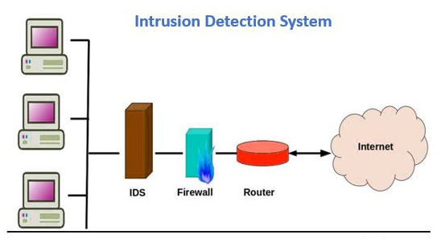
Problem Definition
Implement an network intrusion detection system that discovers anomalies for a software defined network using Random Forest method for classification of port and flow statistics.

Slide 7
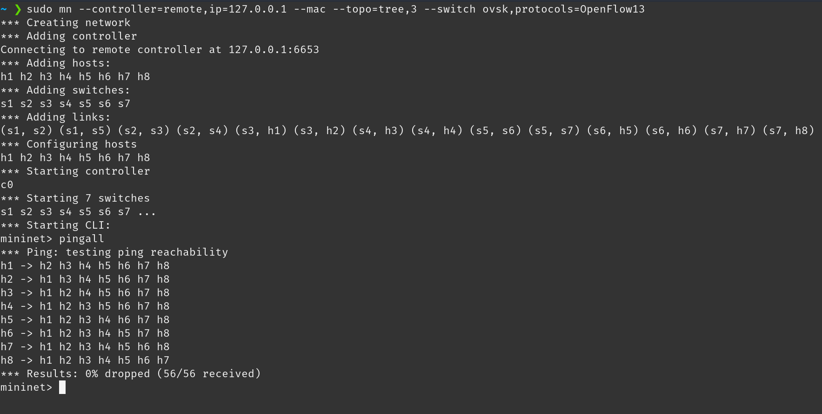
Network Topology

Slide 8
Methodology
Initially, run collectstats.py on the controller.
Then create a mininet custom topology.
Run some simple commands. So that we can generate the clean data. (Label the data as 0, While collecting normal traffic)
Stop the controller.
Now, run the collectstats_1.py file. (Label the data as 1).
Create network topology.
Run hping flood command to capture malicious data.
Now stop the controller.
Run collectstats_predict.py to create the testing data.
Create topology, run simple commands and then, stop the controller.
Finally, run ryuapplication.py on the controller.
Create a topology.
Test the model on the new traffic.

Slide 9
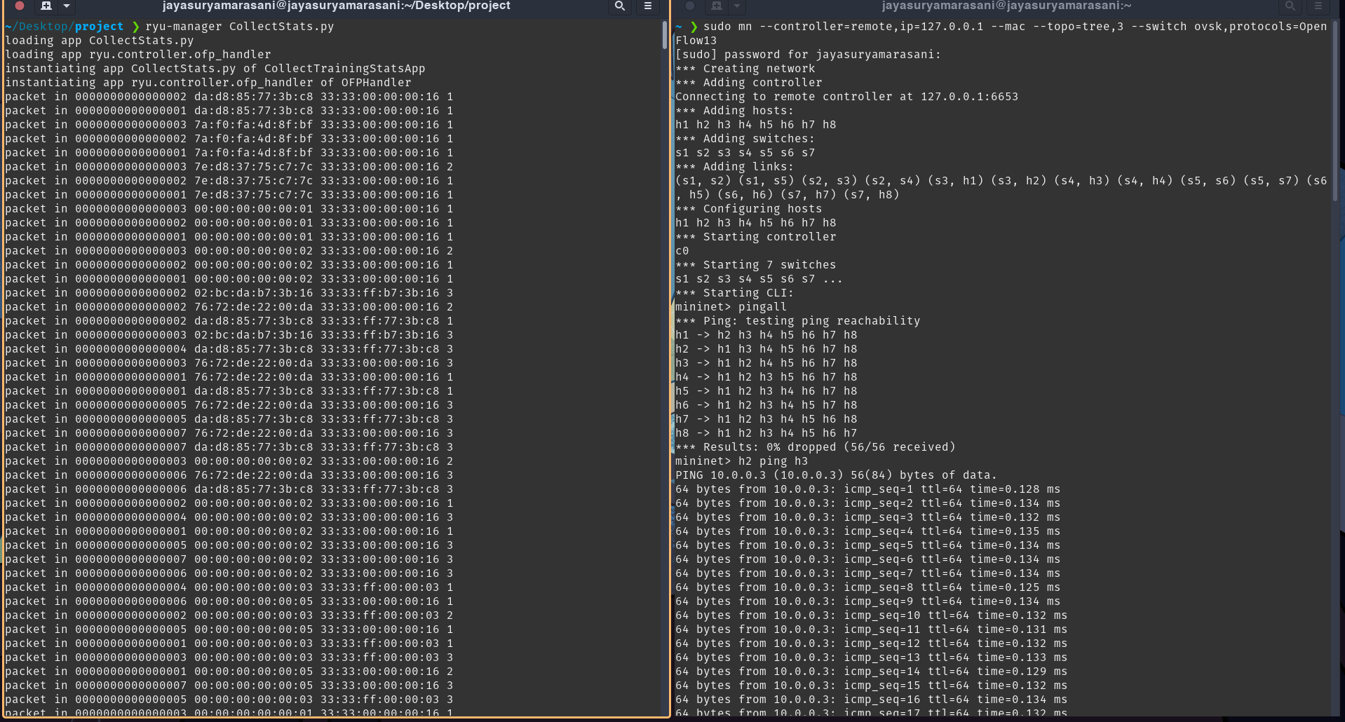
Implementation

Slide 10
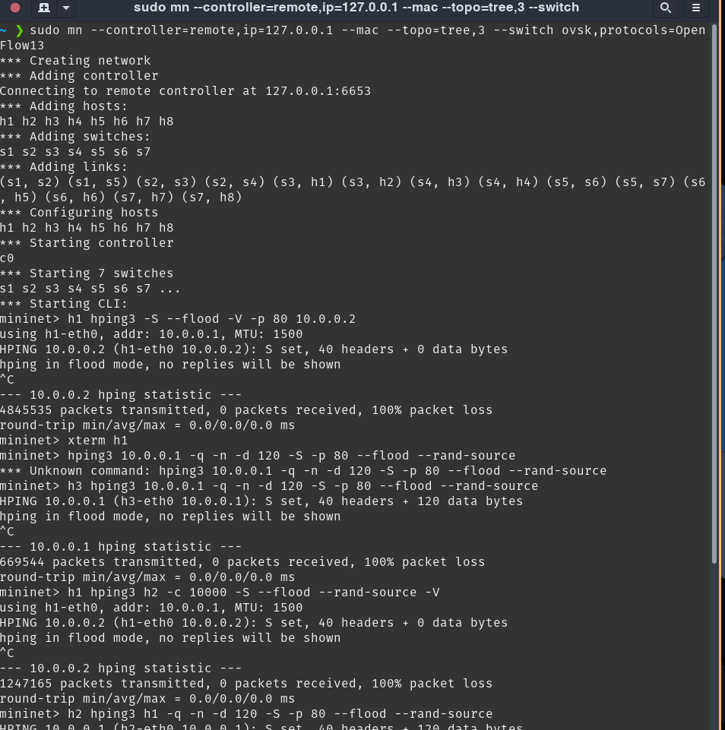
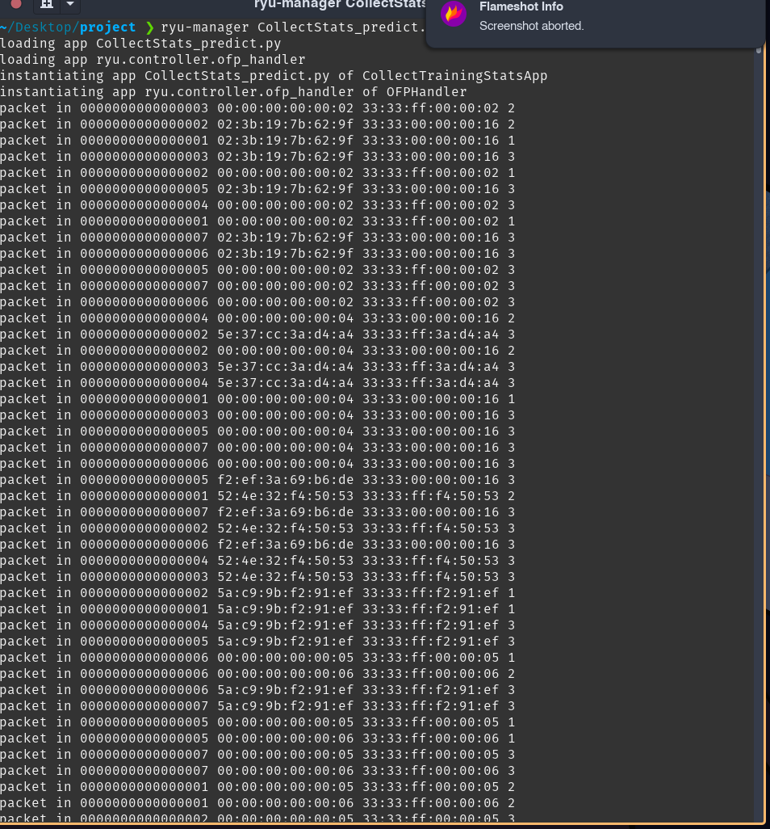

Slide 11
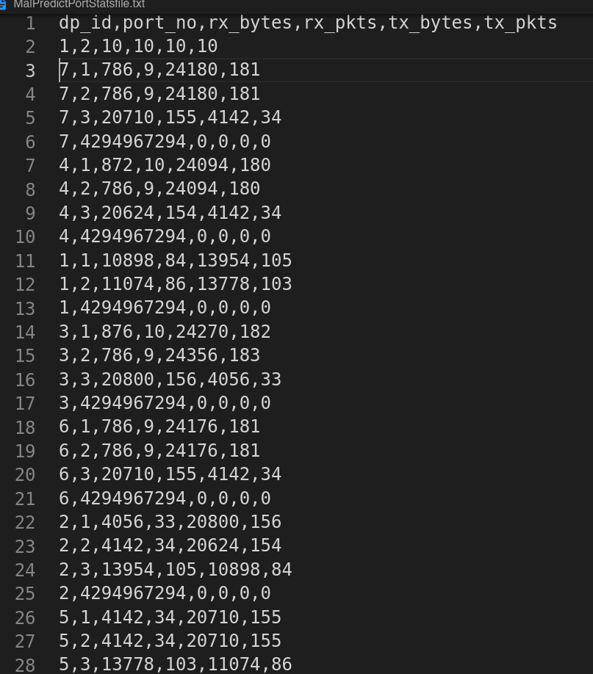
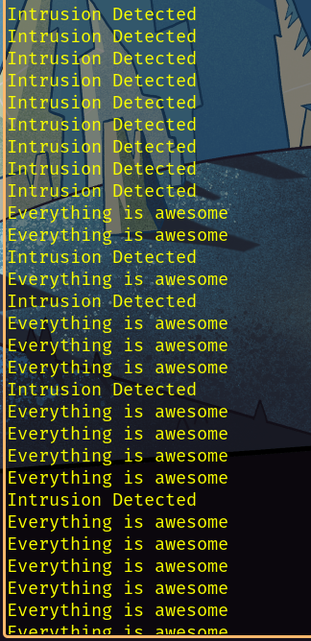
Results

Slide 12
Challenges
Installing ryu controller
Collecting the data and storing in the files
Data preprocessing
Collecting Malicious data for the network
Debugging the python scripts

Slide 13
Conclusion
SDNs enhance networking flexibility by separating the control plane and data plane and removing network architectural privacy while opening and scheduling networks.
In the context of the SDN environment, the deep learning approach has potential.
The information about network traffic can be extracted easily by the controller an evaluated by the deep learning intrusion detection module.
In this project, Network intrusion detection system is designed for a software defined network by using Random Forest method for classification of port and flow statistics.

Slide 14
References
https://www.researchgate.net/publication/220468036_Network_intrusion_detection_system_A_machine_learning_approach
https://www.researchgate.net/publication/344726867_Network_intrusion_detection_system_A_systematic_study_of_machine_learning_and_deep_learning_approaches
https://cybersecurity.springeropen.com/articles/10.1186/s42400-019-0038-7
https://ieeexplore.ieee.org/document/283931
https://ieeexplore.ieee.org/document/7764418

Slide 15
Thank You

